Slide 1
Exploratory Data Analysis: Vidio User Behavior
Muhammad Nashih Amien

Slide 2
2. Sample and Methods
Dataset
Methods
Sampling 10% dataset, renamed as vidio10.csv
Cleaning data from unused data (play duration = 0 and total byte used = 0 byte)
Using correlation matrix to evaluates the relation between variables
Using statistical method to get average of play duration per user
Using statistical method to get correlation between user OS, platform to watch, type of content, and categories.

Slide 3
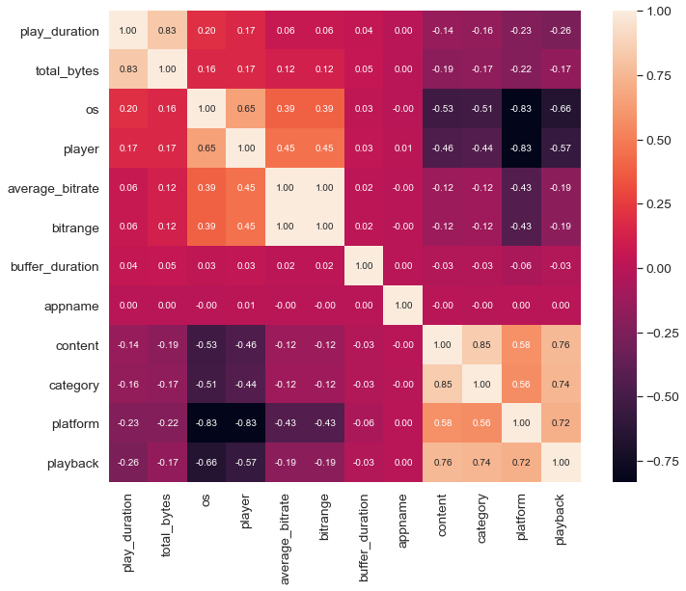
Correlation Matrix
Positive correlation between play duration and total bytes.
Positive with smaller numbers correlation between OS and Vidio player that used.
Perfect positive correlation between average bitrate and user’s bitrate range
Positive correlation between content, video category, user platform, and playback player
Negative correlation between platform, playback, os, and Vidio player.

Slide 4
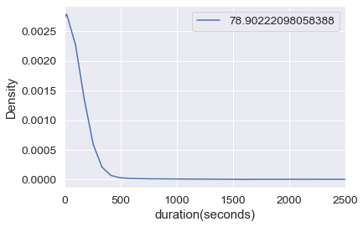
Average User Play Duration
An user in average watch a video on Vidio platform in 78.9 seconds. However, the distribution of data is left-skewed, with median of play duration is in 4 seconds.

Slide 5
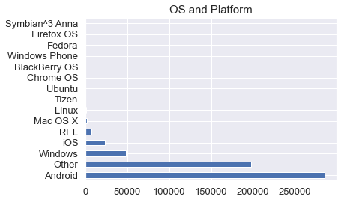
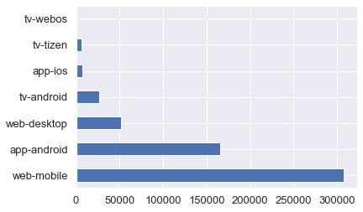
User OS and Platform
Android user is the most dominant Operating System user used to watch Vidio, with the biggest platform used to watch is using mobile web browser.

Slide 6
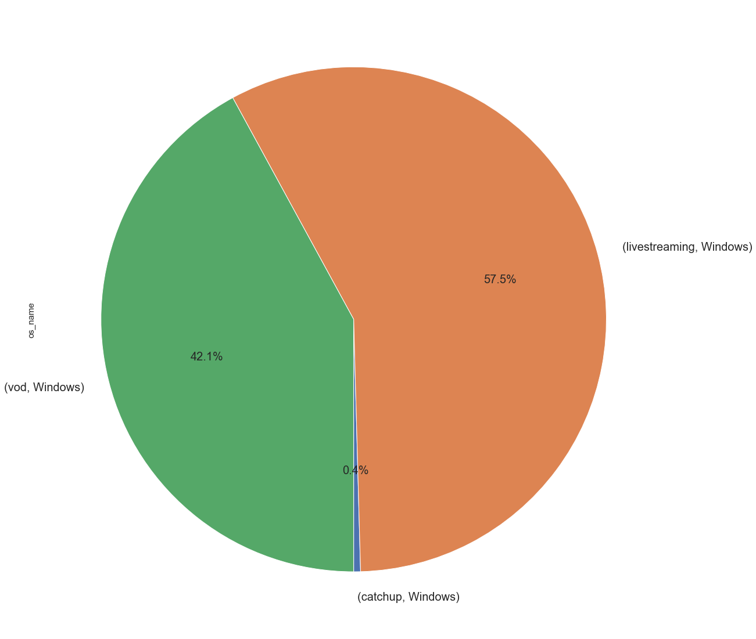
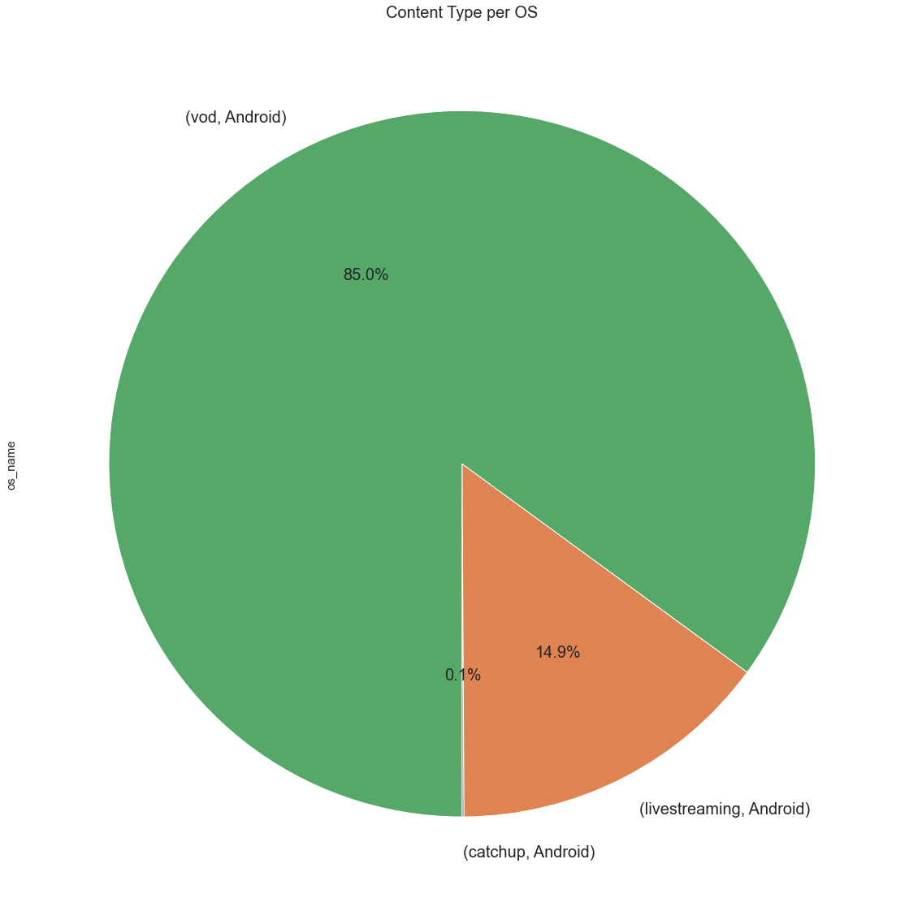
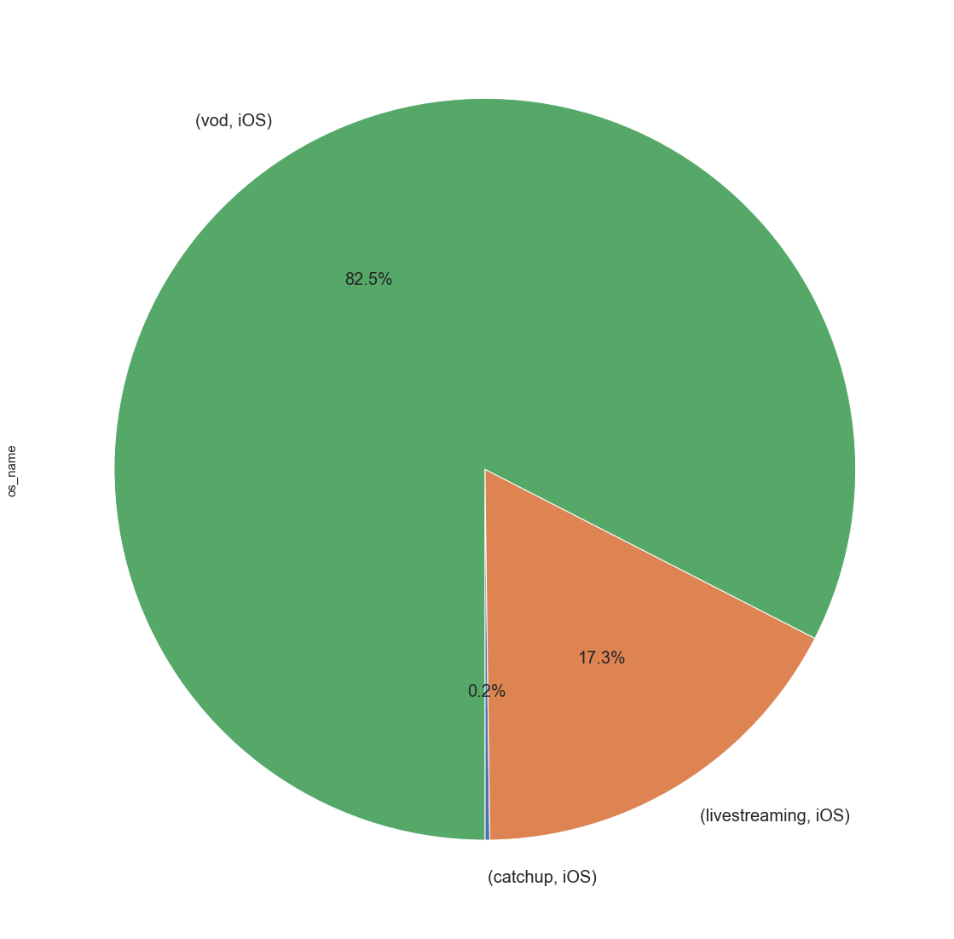
User OS and Content Watched

Slide 7
3. Tools that I Use:
Jupyter Notebook:
Using numpy and statistics to provide statistical information from datas.
Using pandas to manipulate dataframe and categorized column for analysis
Using matplotlib as feature for data visualization
Using confusion matrix to make a correlation matrix and get the relationship between variables

Slide 8
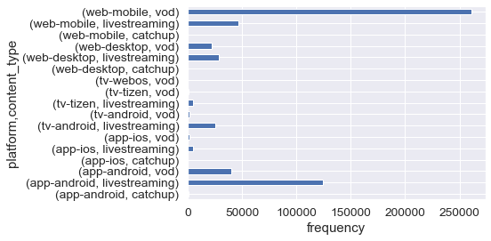
4. User Platform to Watch and Content Type
User usually using mobile web browser to watch Video on Demand, because it will take less bitrate and less data used.
User usually using Android Vidio App to watch live streaming due to find stability in bitrate range and get higher average bitrate.
Android TV user using Vidio to watch live streaming more than other content, because user can get better visual using Android TV than other platform.

Slide 9
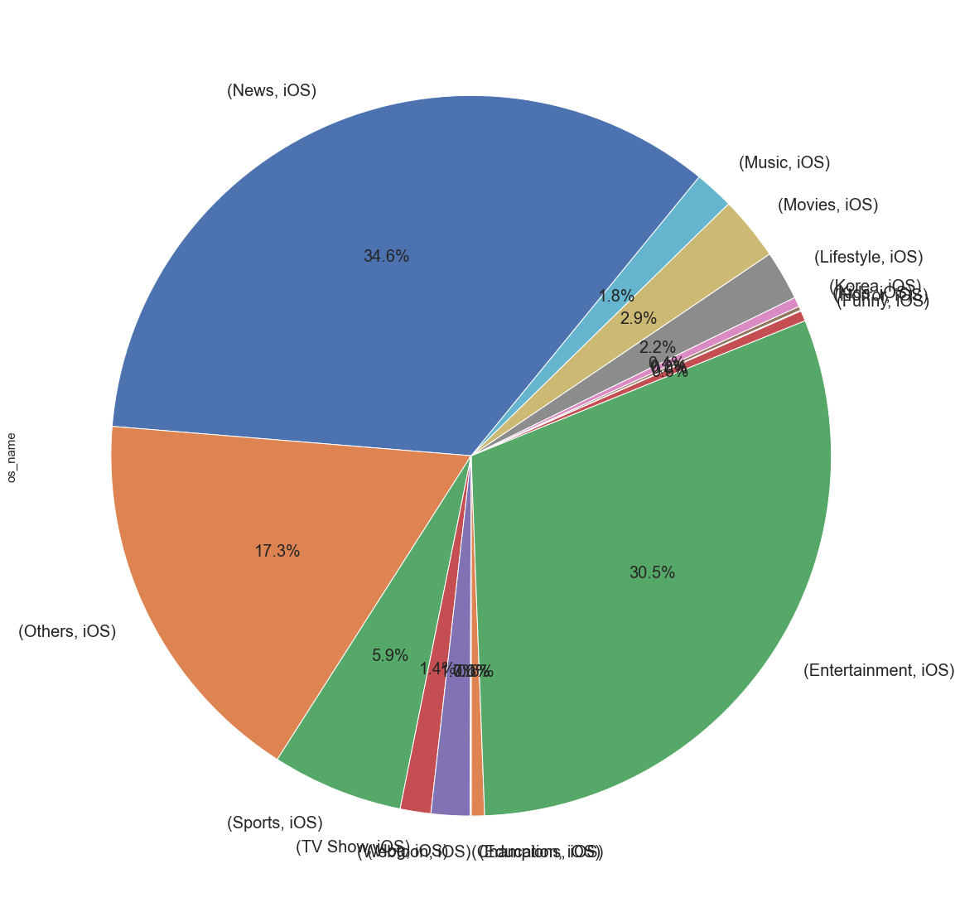
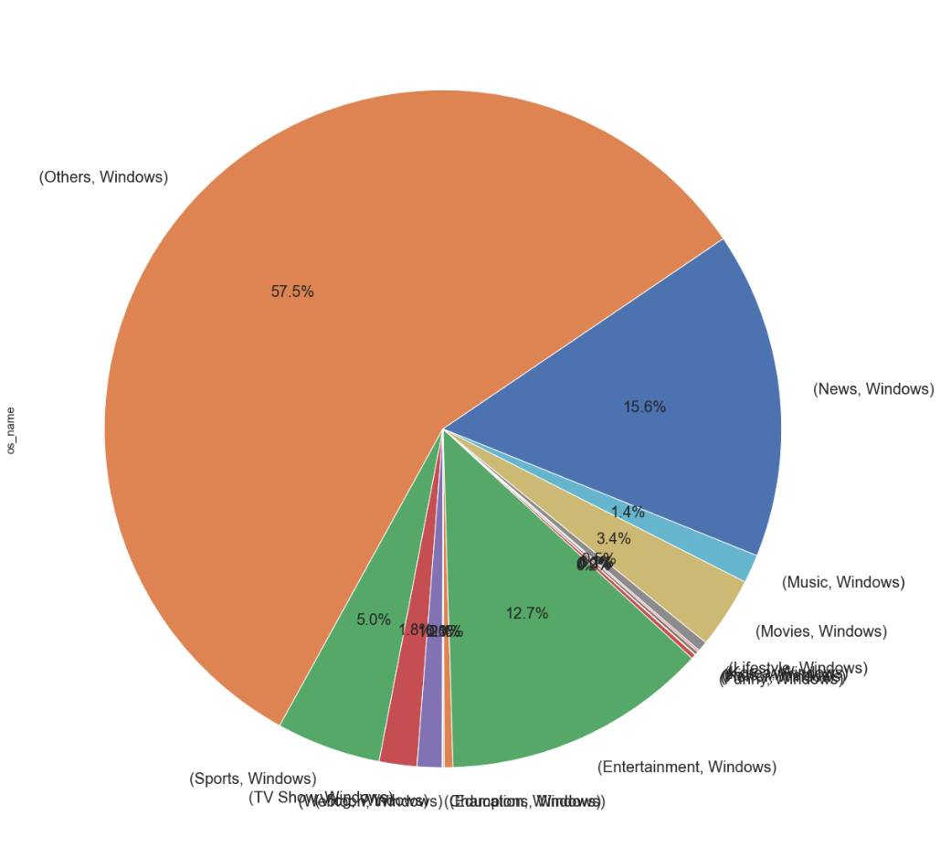
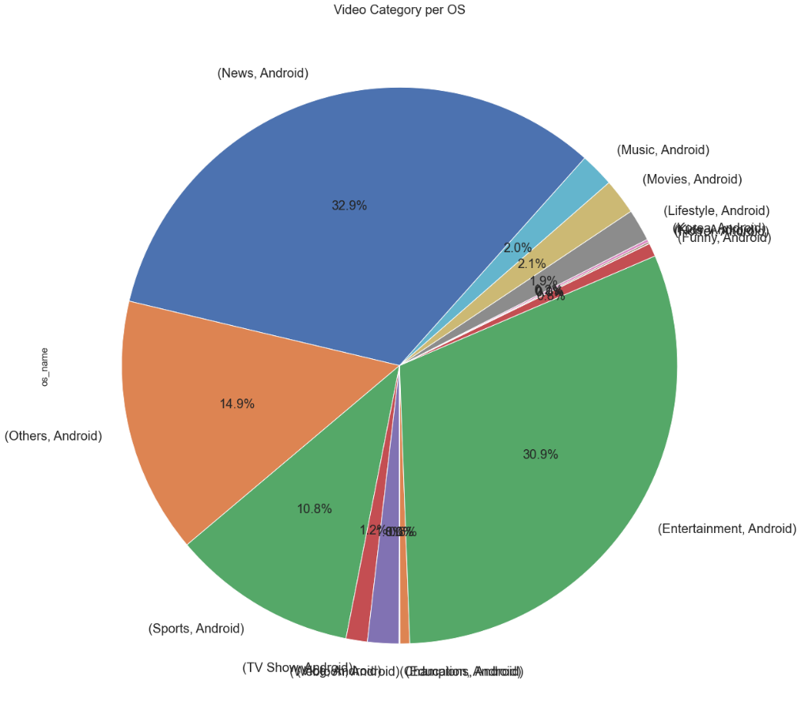

Slide 10
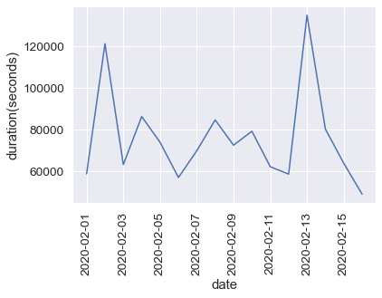
5. User with Highest Play Duration per Day
 | play_time | play_duration | title
0 | 01/02/2020 | 58725 | ã€FULLMOVIEã€‘Watch>> Good Boys Films!2019ã€DOWNLOADã€‘
1 | 02/02/2020 | 121320 | â˜·O1Oâ†”6794â†”8O90â˜·ë•ì •ì¶œìž¥ì•ˆë§ˆâ˜žë§¤ë‹ˆì ¸ëŒ€ê¸°ä¸­â˜œì†¡ì¶”ì¶œìž¥ë§ˆì‚¬ì§€â˜’ï¼¡ecì˜¤í”ˆâ˜’ë•ì •ë™ì¶œìž¥ì•ˆë§ˆï¿¢â€‹ëª©ê±¸ì´ï¿¢ìž¥í¥ì¶œìž¥ë§ˆì‚¬ì§€â†–â„–.1ì†¡ì¶”ì¶œìž¥ì—…ì†Œï½ëŒ€ë°•Â§
2 | 03/02/2020 | 63210 | ã€MVã€‘AKB48 - Single 43rd - LALALA Message (Full ver.)
3 | 04/02/2020 | 86310 | xXx- Return of Xander Cage - Trailer #1 - United International Pictures Indonesia
4 | 05/02/2020 | 73920 | â˜†[Midway]â˜† Full Movie 2019 *Iconic Battle*
5 | 06/02/2020 | 56985 | Û©Peter Rabbit 2: The Runaway â˜… 2020 â˜… Full MovieÛ©
6 | 07/02/2020 | 69870 | wik wik wik,ah ah ah,ih ih...ih.. Viral 2018
7 | 08/02/2020 | 84690 | ã€ M i d w a y ã€‘- Pelicula ( completa24 ) 2019 REPELIS!! Sub.Espanol GRATIS!
8 | 09/02/2020 | 72525 | ð—ªð—®ð—§ð—°ð—› A Quiet Place (2018) fuLL MOViE oNLiNE frEE DoWNLoaD toRRent
9 | 10/02/2020 | 79245 | â€˜1917â€™ Diunggulkan Sebagai Film Terbaik Oscar
10 | 11/02/2020 | 62160 | ð—ªð—®ð—§ð—°ð—› A Quiet Place (2018) fuLL MOViE oNLiNE frEE DoWNLoaD toRRent
11 | 12/02/2020 | 58620 | ã€(Ip Man 4: The Finale)ã€‘ @2019 Official Original Movie
12 | 13/02/2020 | 135075 | {FREE_DOWNLOAD} Bad Boys for Life [2020] Hd~ï¼¦ï¼µï¼¬ï¼¬ ï¼­ï¼¯ï¼¶ï¼©ï¼¥
13 | 14/02/2020 | 80280 | ã€HD`DOWNLOADã€‘CHARLIES ANGELS Full Movie |1080pHD| free download
14 | 15/02/2020 | 63840 | ð—ªð—®ð—§ð—°ð—› A Quiet Place (2018) fuLL MOViE oNLiNE frEE DoWNLoaD toRRent
15 | 16/02/2020 | 48945 | ã€HD`DOWNLOADã€‘CHARLIES ANGELS Full Movie |1080pHD| free download

Slide 11
Thank You

